Slide 1

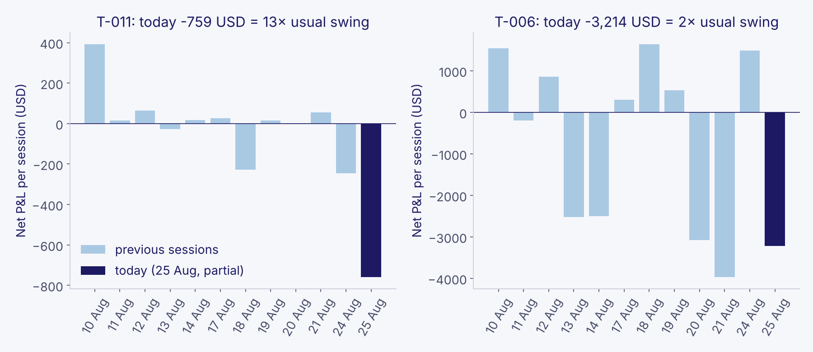
A bad day is measured against that trader’s own normal
RISK REVIEW · SESSION OF 25 AUG
1 · Their normal
Typical net P&L and typical daily swing from each trader’s previous 11 sessions, all accounts combined, after commissions.
2 · Today vs. normal
How many “usual swings” below normal today’s result is. Losing $700 is alarming for someone who moves $60 a day, routine for someone who moves $2,000.
3 · Rank the ten worst
Each name comes with plain evidence: size vs. normal, and whether today is worse than any day before.
Data as of 25 Aug, 09:30 CT. Today’s session is still open (16.5 of 23 hours), so today’s numbers can still move.
Notes:
Key message: we do not rank by dollars lost. We rank by how unusual today is for each trader. Example on the right: T-006 lost four times more money than T-011, but T-006 swings that much on a normal day; T-011 never does. Only sessions before today are used to define normal, so today’s loss cannot water down its own baseline.

Slide 2
Today’s ten, worst first
# | Trader | Today (USD) | Usual swings below normal | Size vs. normal | Worst day so far?
1 | T-011 | −759 | 13× | 1.0× | Yes
2 | T-018 (3 accts) | −1,517 | 11× | 0.9× | Yes
3 | T-019 (2 accts) | −1,559 | 8× | 1.1× | Yes
4 | T-009 | −670 | 7× | 1.2× | Yes
5 | T-020 | −2,398 | 6× | 1.9× | Yes
6 | T-012 | −724 | 5× | 1.3× | Yes
7 | T-023 | −2,486 | 5× | 1.0× | Yes
8 | T-044 | −560 | 3× | 0.3× | No
9 | T-008 | −459 | 3× | 0.8× | Yes
10 | T-029 | −414 | 3× | 0.8× | No
Too new to rank
T-024 (−$1,580, first day, 38 contracts), T-025 (account balance $0), T-026. No history means no “normal”: review by hand.
What this is not
Not a prediction of liquidation. “Normal” rests on 11 sessions. A flag is a reason to look, not a verdict.
Net of commissions; open positions valued at 09:30 CT marks. Size = contracts traded today vs. that trader’s usual session.
Notes:
Read a row like this: T-020 is down $2,398, six times their usual daily swing, trading almost twice their usual volume, and it is already their worst session. Rows 2 and 3 combine several accounts of the same person, because the firm absorbs the loss across all of them. The three new traders are not ignored: they are listed separately because the method needs history to say what is unusual.

